Slide 1
Flexible Communication Avoiding Matrix Multiplication on FPGA with High-Level Synthesis
r13942119 方爾秋
b10507062 謝睿宇

Slide 2
Introduction
Resource
I/O efficiency
Hardware implementation
Code Implementation
Execute and Result

Slide 3
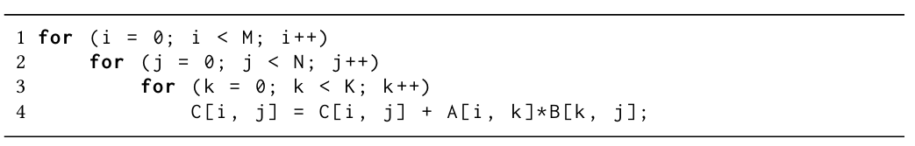
Optimal goals
Classical Matrix Matrix Multiplication
The classical algorithms often perform better on practical problems and hardware [1], so Strassen-like routines are excluded.
[1] Paolo D’Alberto and Alexandru Nicolau. 2008. Using recursion to boost ATLAS’s performance.In High-Performance Computing. Springer, 142–151.

Slide 4
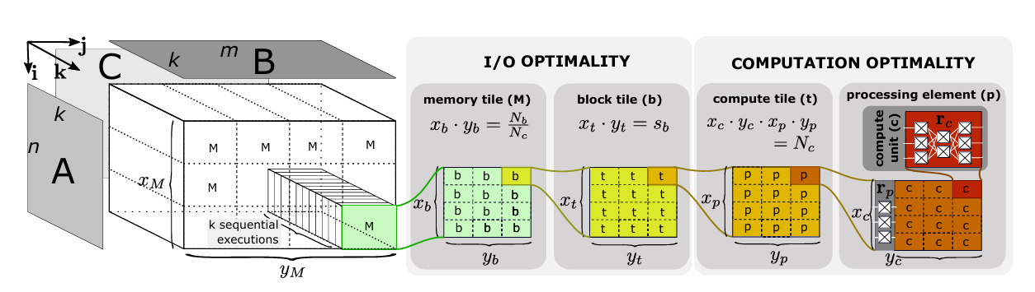

Design Overview
Configurable MMM hierarchy
The target platform has $N_{b}$ block RAMs.
The target platform has $N_{c}$ compute units.
A single block RAM can store $S_{b}$​ words of the target data type.

Slide 5

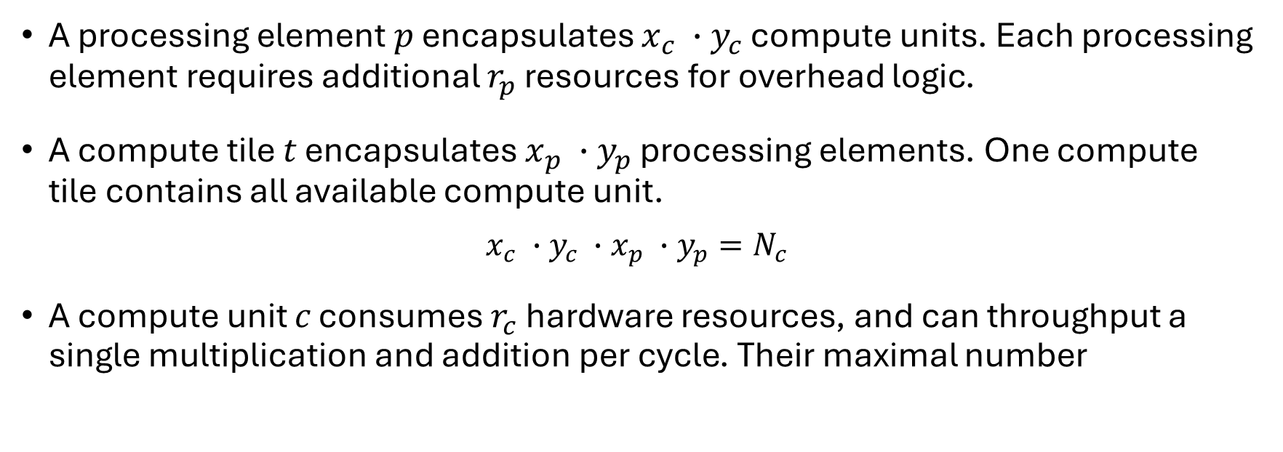
Computation Resource
A processing element 𝑝 encapsulates $x_{c} ∙y_{c}$ compute units. Each processing element requires additional $r_{p}$ resources for overhead logic.
A compute tile 𝑡 encapsulates $x_{p} ∙y_{p}$ processing elements. One compute tile contains all available compute unit.
$x_{c} ∙y_{c}$ $∙x_{p} ∙y_{p}=N_{c}$
A compute unit 𝑐 consumes $r_{c}$ hardware resources, and can throughput a single multiplication and addition per cycle. Their maximal number

Slide 6
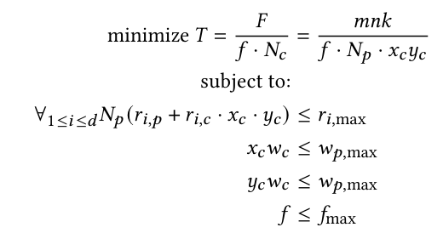
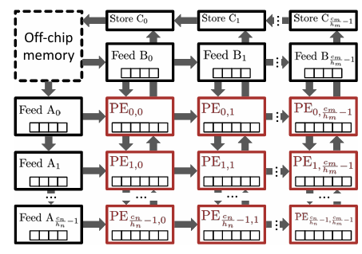

Computation Resource
When we factor in the additional overhead logic of the PE and the maximum data bus width between PEs ($w_{p}$​), another constraint on the compute unit and the throughput of compute tile can be obtained, as shown below.

Slide 7
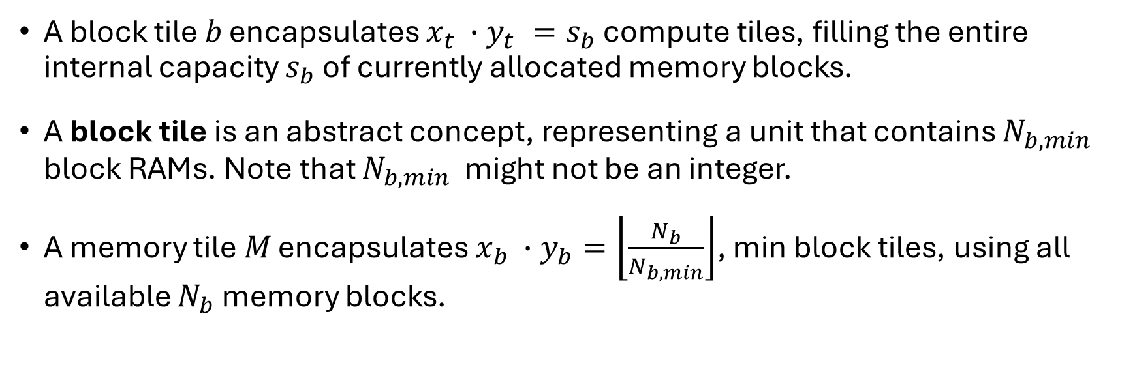
Memory Resource
A block tile 𝑏 encapsulates $x_{t} ∙y_{t} =s_{b}$ compute tiles, filling the entire internal capacity $s_{b}$ of currently allocated memory blocks.
A block tile is an abstract concept, representing a unit that contains $N_{b, min}$​ block RAMs. Note that $N_{b, min}$​ might not be an integer.
A memory tile 𝑀 encapsulates $x_{b} ∙y_{b}=\left\lfloor \frac{N_{b}}{N_{b, min}}\right\rfloor$, min block tiles, using all available $N_{b}$ memory blocks.

Slide 8
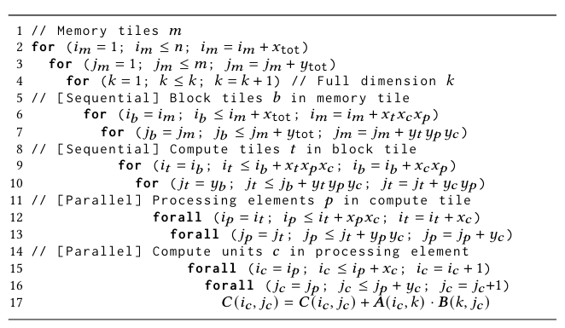
Pseudocode of the tiled MMM algorithm

Slide 9
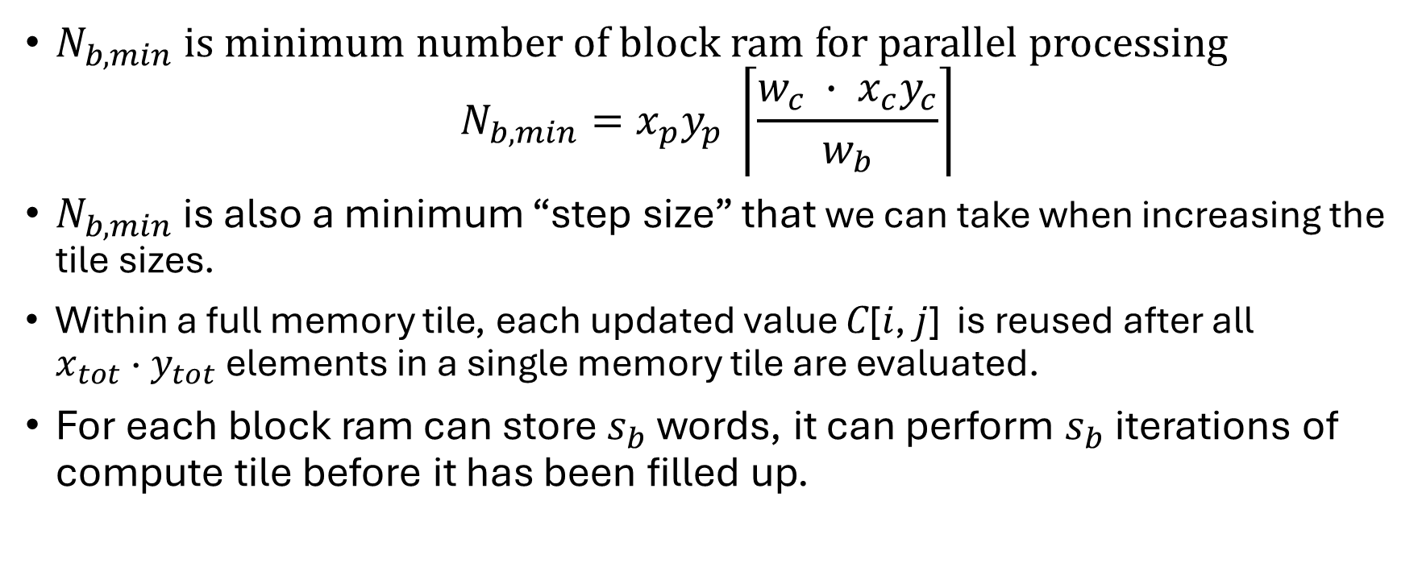
Parallel Resource
$N_{b, min}$ is minimum number of block ram for parallel processing
$$N_{b, min}=x_{p}y_{p} \left\lceil \frac{{w_{c} ∙ x}_{c}y_{c}}{w_{b}}\right\rceil$$
$N_{b, min}$ is also a minimum “step size” that we can take when increasing the tile sizes.
Within a full memory tile, each updated value 𝐶[𝑖, 𝑗] is reused after all $x_{tot}$ · $y_{tot}$ elements in a single memory tile are evaluated.
For each block ram can store $s_{b}$ words, it can perform $s_{b}$ iterations of compute tile before it has been filled up.

Slide 10
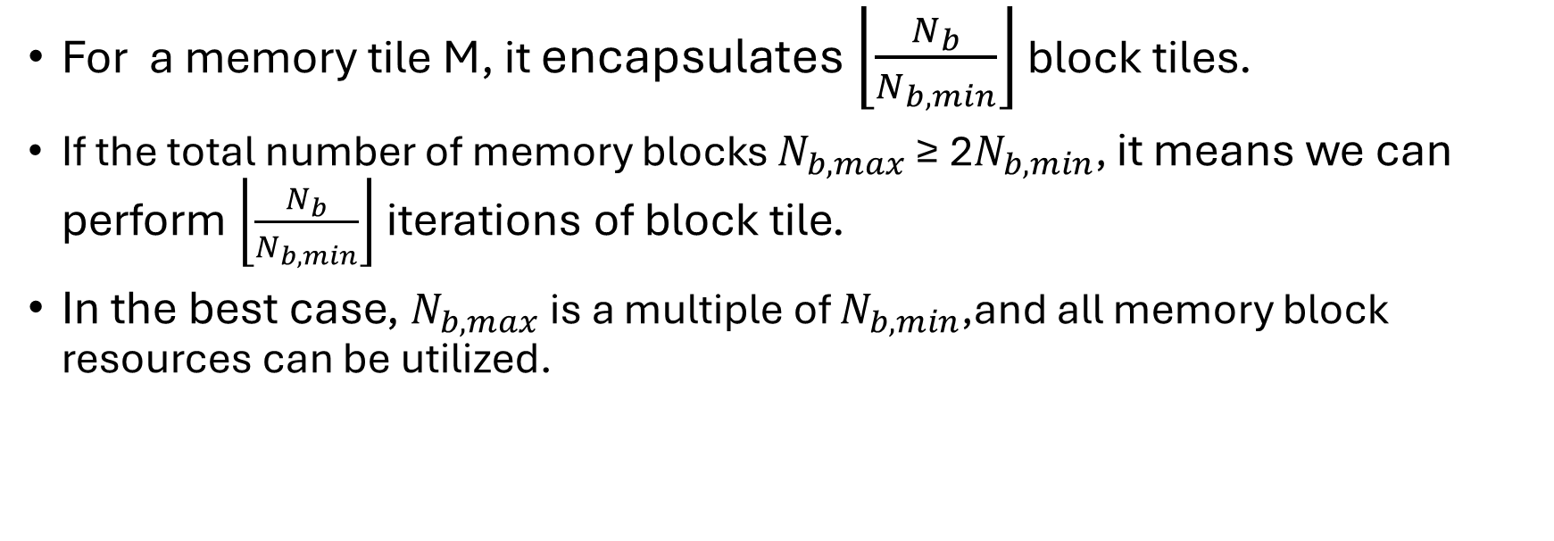
Parallel Resource
For a memory tile M, it encapsulates $\left\lfloor \frac{N_{b}}{N_{b, min}}\right\rfloor$ block tiles.
If the total number of memory blocks $N_{b, max}$ ≥ 2$N_{b, min}$, it means we can perform $\left\lfloor \frac{N_{b}}{N_{b, min}}\right\rfloor$ iterations of block tile.
In the best case, $N_{b, max}$is a multiple of $N_{b, min}$,and all memory block resources can be utilized.

Slide 11
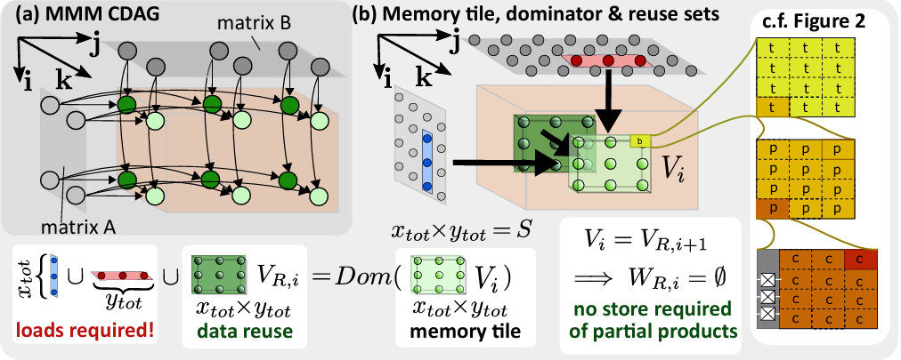
I/O model
We represent an entire execution of an algorithm as a computation directed acyclic graph (CDAG)
In the context of MMM, matrices 𝐴 and 𝐵 for 𝑚 ×𝑘 and 𝑘 ×𝑛 input vertices, respectively, and partial sums of 𝐶 for 𝑚𝑛𝑘 intermediate vertices

Slide 12
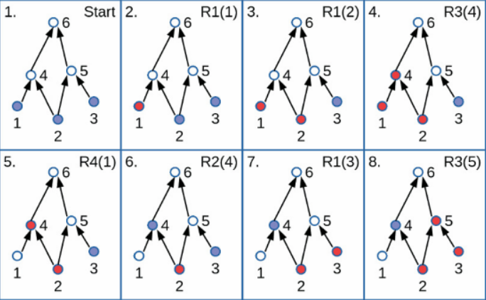
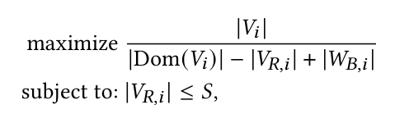
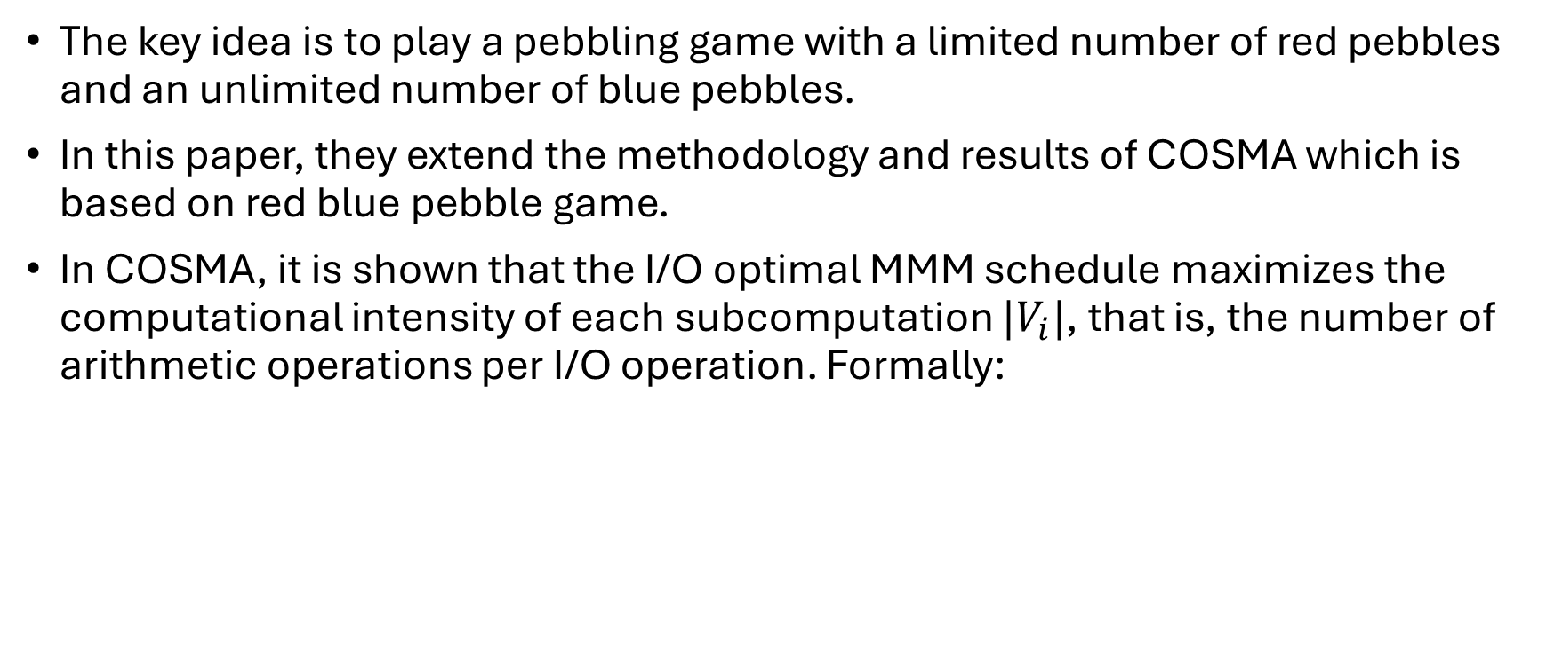
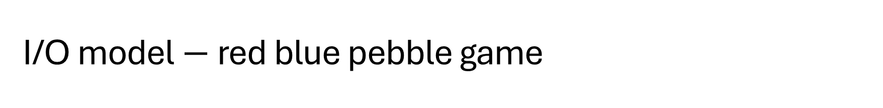
I/O model $−$ red blue pebble game
The key idea is to play a pebbling game with a limited number of red pebbles and an unlimited number of blue pebbles.
In this paper, they extend the methodology and results of COSMA which is based on red blue pebble game.
In COSMA, it is shown that the I/O optimal MMM schedule maximizes the computational intensity of each subcomputation $|V_{i}|$, that is, the number of arithmetic operations per I/O operation. Formally:

Slide 13
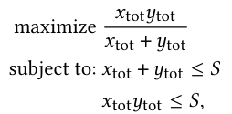



FPGA-constrained I/O Minimization
The machine contains $N_{b}$ on-chip memory blocks, each capable of holding $s_{b}$ words of the target data type, yielding a maximum of words that can be held in on-chip memory
𝑆 = $N_{b}$· $s_{b}$
$x_{tot}$= $x_{c}∙x_{p}$ $∙x_{t}$ $∙x_{b}, { y}_{tot}$= $y_{c}∙y_{p}$ $∙y_{t}$ $∙y_{b}$

Slide 14
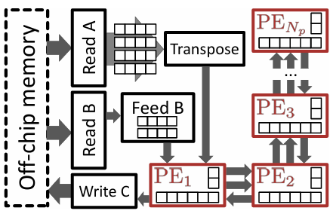

Hardware Implementation
Routing congestion
If input was broadcasted directly, it would lead to a total fan-out of
$x_{p}·y_{p}$for both inputs

Slide 15
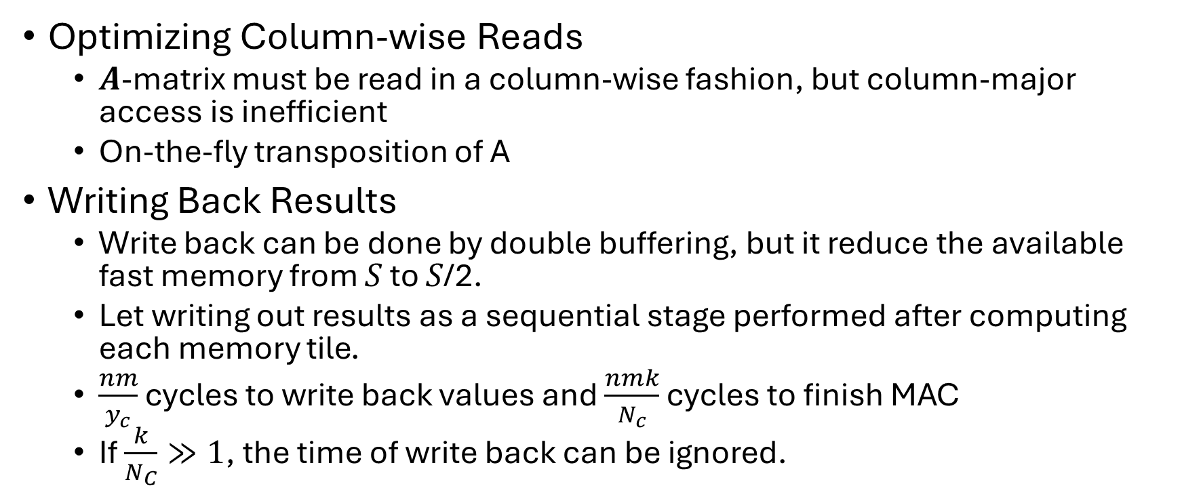
Hardware Implementation
Optimizing Column-wise Reads
𝑨-matrix must be read in a column-wise fashion, but column-major access is inefficient
On-the-fly transposition of A
Writing Back Results
Write back can be done by double buffering, but it reduce the available fast memory from 𝑆 to 𝑆/2.
Let writing out results as a sequential stage performed after computing each memory tile.
$\frac{nm}{y_{c}}$ cycles to write back values and $\frac{nmk}{N_{c}}$ cycles to finish MAC
If $\frac{k}{N_{C}}≫1$, the time of write back can be ignored.

Slide 16
Hardware Implementation
Data dependency
FPGA Limitation: Floating-point accumulation is not a native, highly optimized operation on FPGAs.
Consequence: This often introduces loop-carried dependencies on the accumulation variable.
Meaning: Each accumulation step relies on the previous one's result.
Impact: This severely hinders pipelining, preventing efficient, continuous data flow through the processing pipeline.

Slide 17
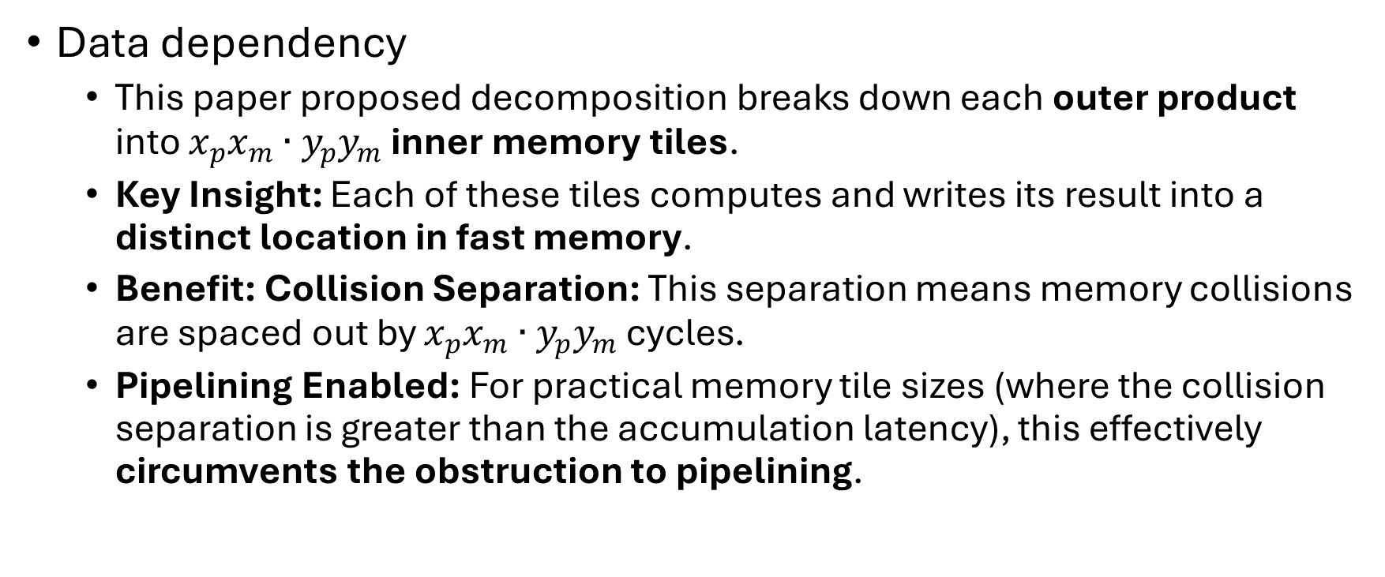
Hardware Implementation
Data dependency
This paper proposed decomposition breaks down each outer product into $x_{p}x_{m}∙y_{p}y_{m}$ inner memory tiles.
Key Insight: Each of these tiles computes and writes its result into a distinct location in fast memory.
Benefit: Collision Separation: This separation means memory collisions are spaced out by $x_{p}x_{m}∙y_{p}y_{m}$​ cycles.
Pipelining Enabled: For practical memory tile sizes (where the collision separation is greater than the accumulation latency), this effectively circumvents the obstruction to pipelining.

Slide 18


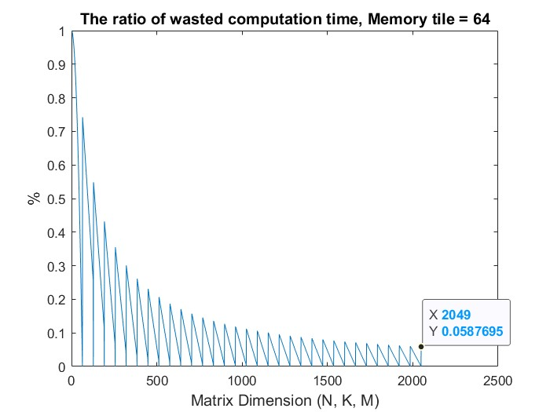
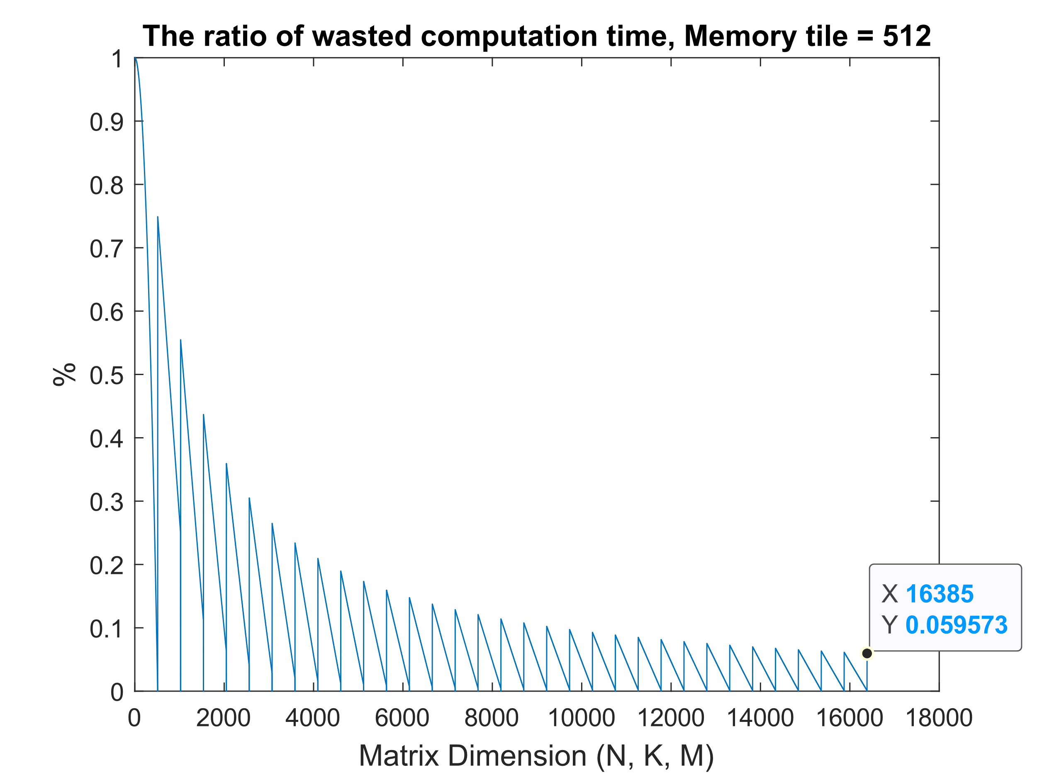
Throughput Drop

Slide 19
Code Implementation
Instruction Parameter
TOP.cpp
Memory.cpp
Compute.cpp

Slide 20
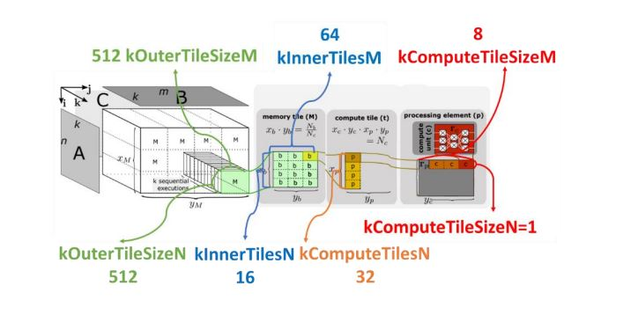
Instruction Parameter
DMM_DATA_TYPE: Specifies the data type of the input/output matrices, such as float, int, double, etc.
DMM_PARALLELISM_N: Represents the number of processing elements (PEs) within an inner tile that will run in parallel. This corresponds to kComputeTilesN in Figure .

Slide 21
Instruction Parameter
DMM_PARALLELISM_M: Indicates the size of a processing element (PE), or the number of compute units it possesses. This aligns with kComputeTileSizeM in Figure.
DMM_MEMORY_TILE_SIZE_N: Refers to the size of an outer tile in the N dimension, denoted as kOuterTileSizeN.
DMM_MEMORY_TILE_SIZE_M: Denotes the size of an outer tile in the M dimension, represented as kOuterTileSizeM.

Slide 22
Instruction Parameter
kInnerTilesN is obtained by dividing the kOuterTileSizeN by kComputeTileSizeM.
kInnerTilesM is obtained by dividing the kOuterTileSizeM by kComputeTilesN.
cmake ../ -DMM_DATA_TYPE=float -DMM_PARALLELISM_N=16 -DMM_PARALLELISM_M=4 -DMM_MEMORY_TILE_SIZE_N=64 -DMM_MEMORY_TILE_SIZE_M=64

Slide 23
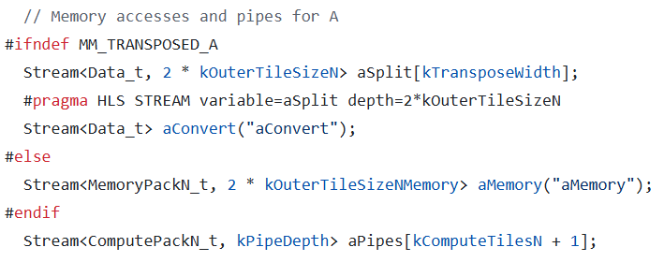

TOP.cpp
If transposed A is defined, store A value in aMemory.
If transposed A is not defined, using aSplit for the tanspose function and converts the memory width.

Slide 24
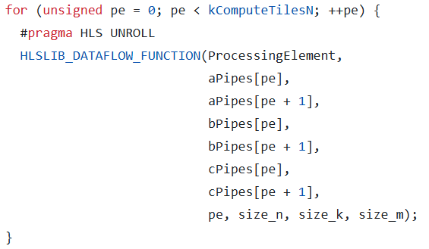
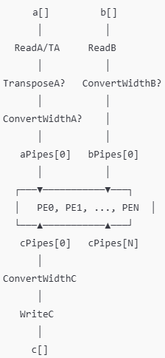
TOP.cpp

Slide 25
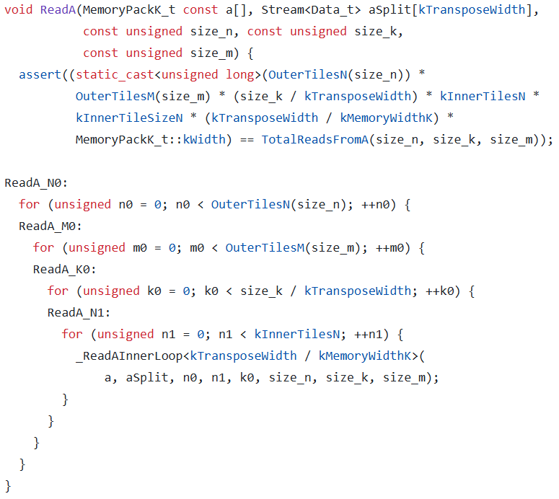
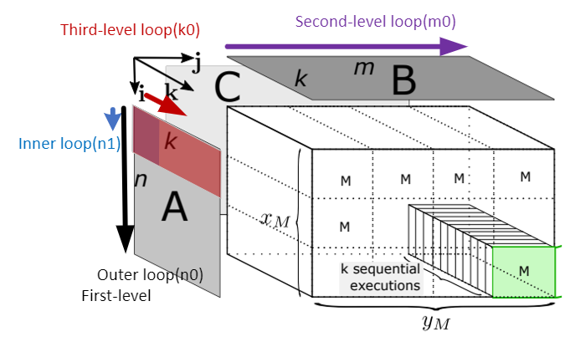
Memory.cpp-ReadA
kInnerTileN : number of inner tile
kInnerTileSizeN : how many rows of an inner tile

Slide 26
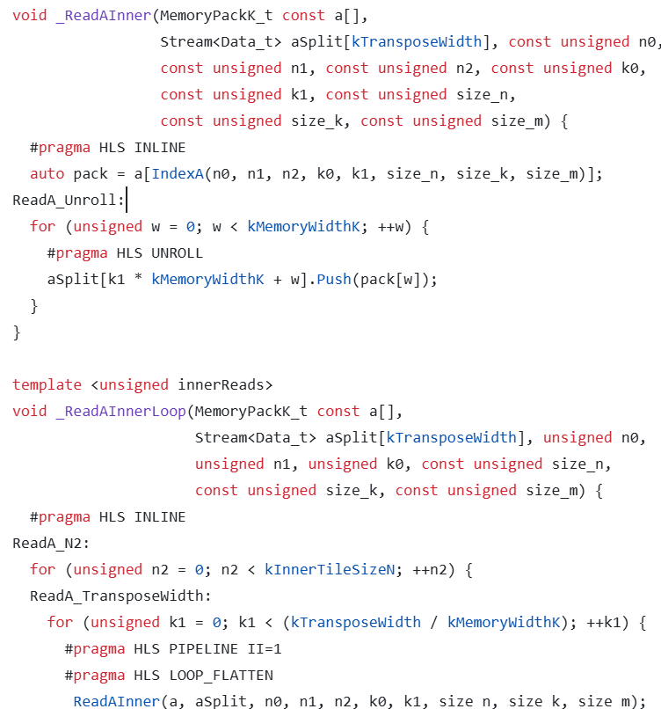
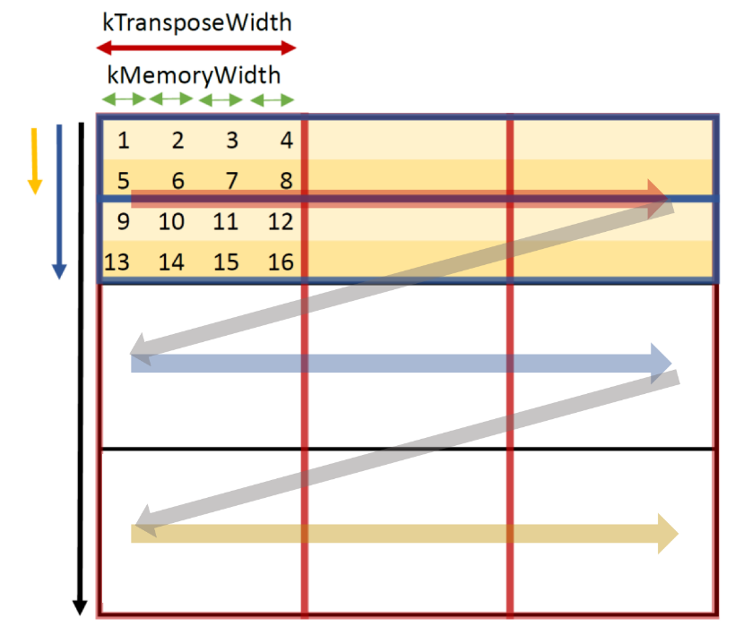
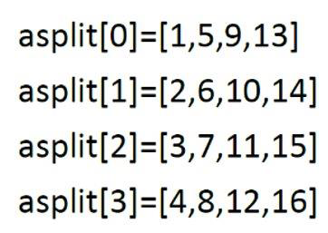
Memory.cpp-ReadA

Slide 27
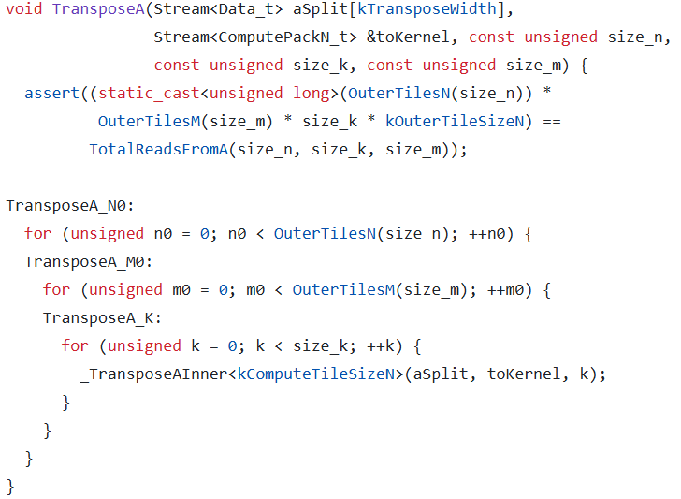
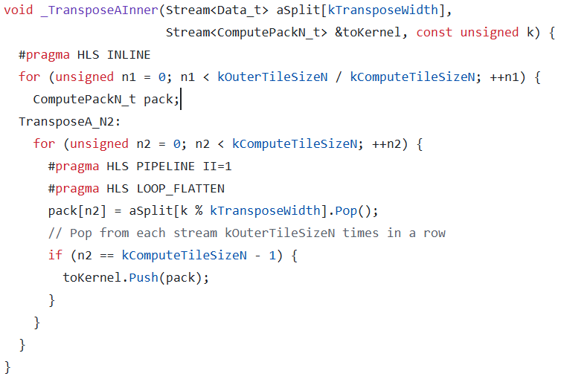
Memory.cpp-TransposeA

Slide 28
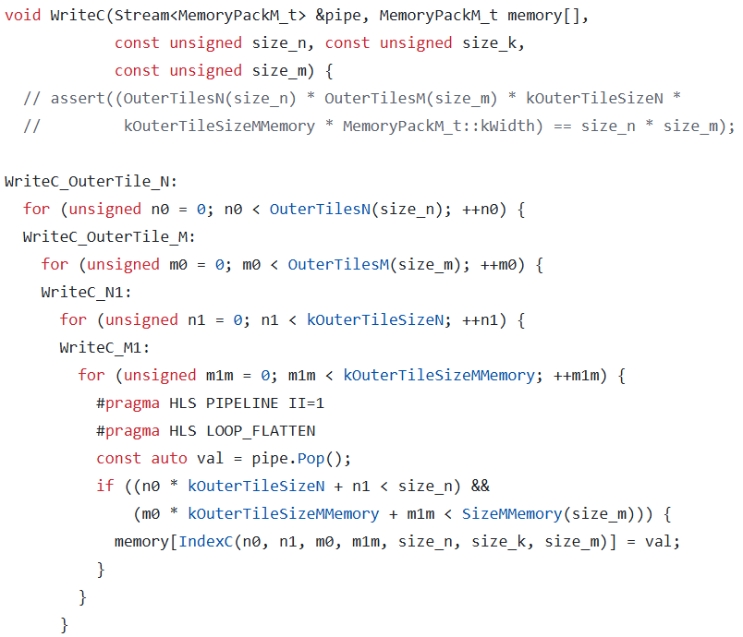
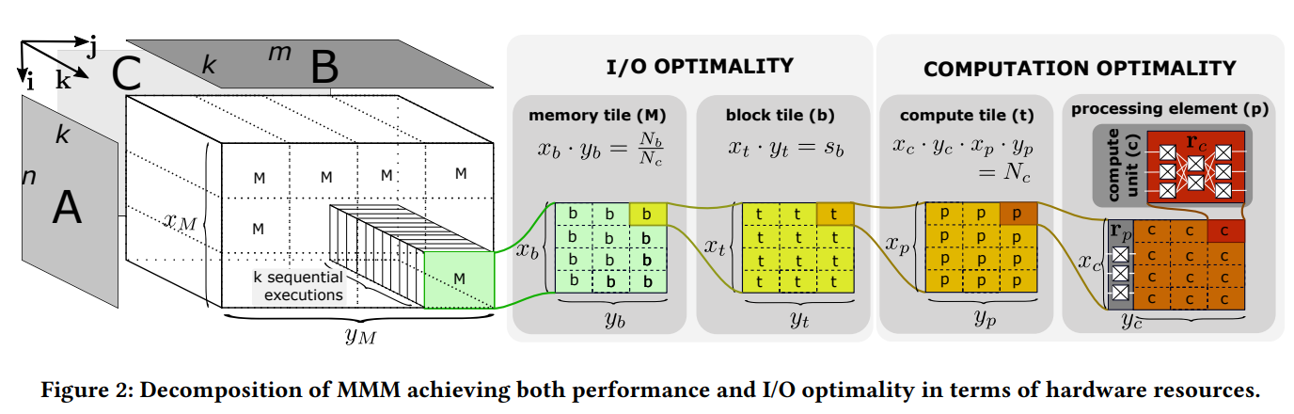
Memory.cpp-WriteC

Slide 29
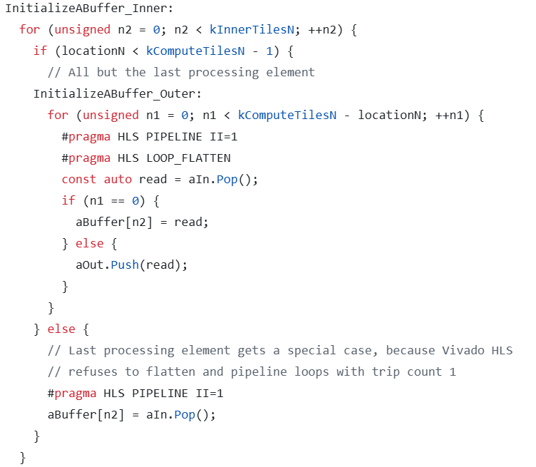
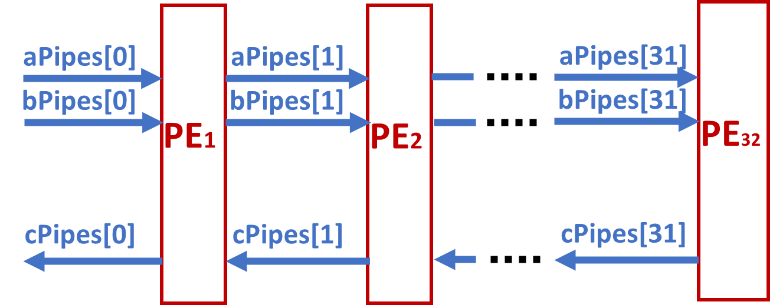
Compute.cpp

Slide 30
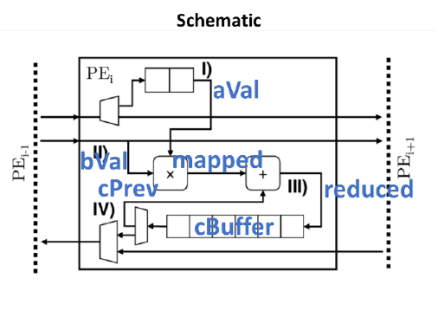
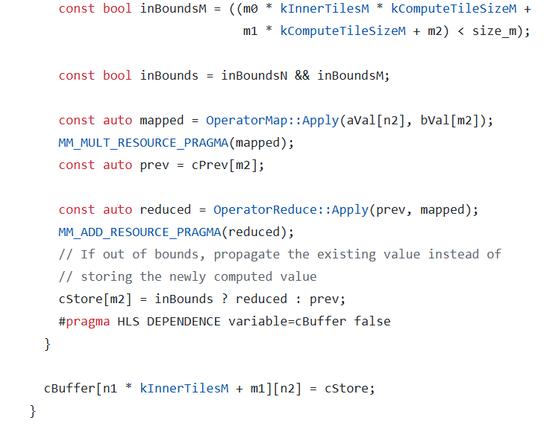
Compute.cpp
OperatorMap::Apply(a, b)： a × b
OperatorReduce::Apply(prev, mapped)：prev + mapped
inBounds : whether it is out of bound

Slide 31
Execute and Results
Execute Flow
Result

Slide 32
Execute Flow
Following the commands on github with some modification
source /opt/Xilinx/Vitis/2021.1/settings64.sh
mkdir build
cd build
cmake ../ -DMM_DATA_TYPE=float -DMM_PARALLELISM_N=16 -DMM_PARALLELISM_M=4 -DMM_MEMORY_TILE_SIZE_N=64 -DMM_MEMORY_TILE_SIZE_M=64
make
make hw_emu
./RunHardware.exe 64 64 64 hw_emu

Slide 33
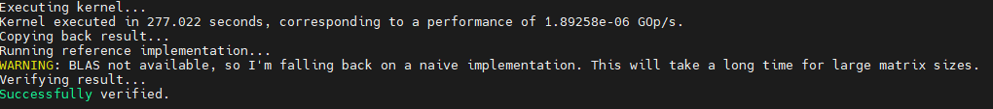
Results

Slide 34
Contribution
方爾秋 | 謝睿宇
Paper Explanation | Code Implementation
Environment Checking | Execute and Result

